Slide 1


Life Insurance Benefits
- LGH-provided Life
- Supplemental Term Life
- Universal Life and Long-Term Care
- Accidental Death and Dismemberment
Effective July 1, 2024
LIVE YOUR LEGACY
Notes:
Penn Medicine Lancaster General Health offers multiple benefits to help ensure your loved ones are taken care of in the event of your death or long-term illness. We will highlight each of these benefits that can help provide peace of mind now and in the future.
The benefits described here reflect changes that are effective July 1, 2024.

Slide 2

LGH-provided Life Insurance
1 x your base annual salary
.5 FTE or greater
1st of month following date of hire
Notes:
On the first of the month following your date of hire if you work .5 FTE or greater, LG Health provides you with Life Insurance coverage. If you die while employed by LG Health, benefits will be paid to your surviving beneficiaries in a lump-sum equal to one times your base annual salary, rounded to the next higher $1,000, up to $1 million. Eligibility and multiples may differ for certain positions.
This insurance is provided automatically; you don’t have to elect or pay for it. But you DO need to designate your beneficiaries, for the people who will receive your benefit if you die. If you haven’t designated beneficiaries, or you need to make updates, I encourage you to log in to Workday right away to make your wishes clear.
LGH will no longer pay for this coverage if you become ineligible, due to a change in your FTE or leaving LG Health. But you can arrange to continue coverage on your own.

Slide 3

Supplemental Term Life — For Yourself
Multiples of your base annual salary – lesser of 8x base or $1 million
Statement of Health required
Notes:
If you would like to increase your total life insurance benefit amount, you can elect supplemental term life coverage for yourself, your spouse and your children through Securian. You pay for it after-tax through the convenience of payroll deduction.
Term life insurance provides a benefit to your beneficiaries upon your death. It does not have a cash value and ends when you stop paying premiums.
For yourself, you can elect to purchase amounts in increments of $10,000, up to the lesser of eight times your base annual salary or $1 million. For increases more than $20,000 or benefit amounts greater than $250,000 or 2 times your base annual earnings, whichever is less, your coverage will require approval based on your Statement of Health. Also note that any initial application for supplemental coverage after the first 30 days of employment requires a Statement of Health.

Slide 4

Supplemental Term Life — For Your Family
Spouse
Up to $250,000
Children up to age 26
$5,000, $10,000 or $15,000
Statement of Health required for some options
Notes:
If you purchase Supplemental Term Life Insurance for yourself, you can also cover your spouse for up to $250,000, as long as that amount doesn’t exceed 50% of your supplemental benefit amount. For amounts over $50,000, your spouse will need to complete a Statement of Health.
And you can purchase benefit coverage of $5,000, $10,000 or $15,000 for each of your children, to age 26. No Statement of Health is required for child coverage.
Term life insurance is effective only while you are paying for it. If you leave LG Health or stop paying for it, you will no longer be covered, unless you arrange with the carrier directly to continue your coverage.
You can enroll anytime at lifebenefits.com. Be sure to designate your beneficiaries when you enroll and keep them updated.

Slide 5

Universal Life and
Long-Term Care
Adjustable premiums
Cash value
Death benefit
Optional long-term care benefits
Look for enrollment invitation from Allstate
Notes:
Universal Life Insurance is different from term life insurance. It’s a permanent benefit that stays with you, as long as you keep paying the premium – even after you leave or retire. It can include adjustable premiums and provide a cash value, along with a death benefit.
This policy also includes a long-term care benefit option.
You’ll be invited in the spring each year to enroll in Universal Life Insurance and Long-Term Care from Allstate. Again, be sure to designate your beneficiaries when you enroll.
You can pay for this after-tax benefit through payroll deduction.

Slide 6
Accidental Death and Dismemberment
Increments of $10,000
Maximum = lesser of 8x base annual
earnings or $1 million
Spouse
50% of your coverage up to $250,000
Children
15% of your coverage up to $15,000
Look for enrollment information from Securian
Notes:
Accidental Death and Dismemberment insurance from Securian provides benefits to assist you or your loved ones if you die or are dismembered by an accident.
This coverage is available in increments of $10,000 for a maximum of $1 million or 8 x your base annual salary, whichever is less. You can also cover your spouse for 50% of your own coverage level, up to $250,000 and your children for 15% of your coverage up to $15,000. See the policy for benefits related to dismemberment.
You will receive enrollment information directly from Securian. Once again, please be sure to include your beneficiaries when you enroll.

Slide 7
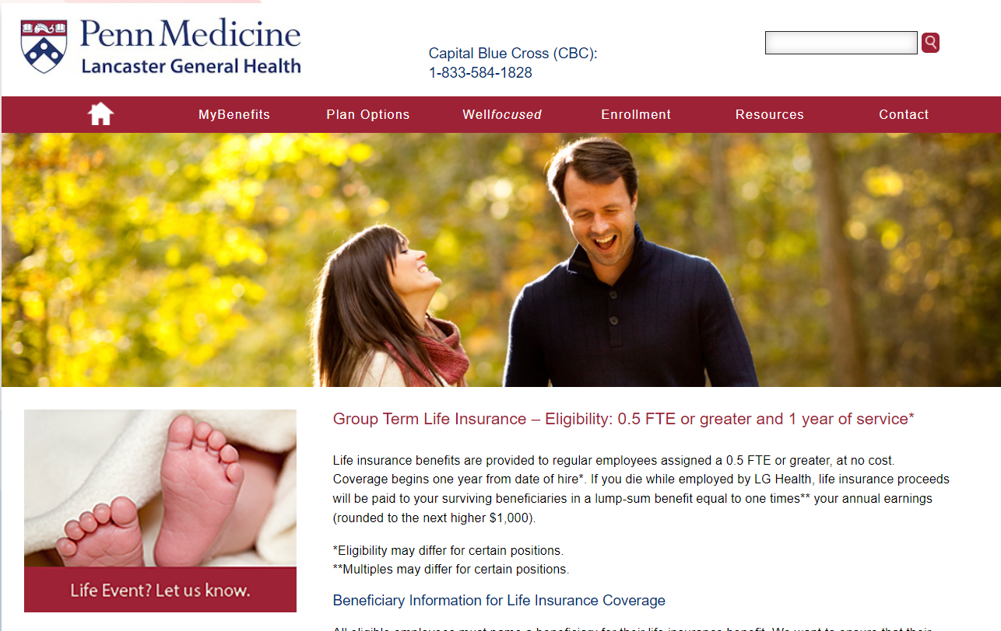
Learn More
lghealthbenefits.com
LGH-benefits@pennmedicine.upenn.edu
Questions? Call 717-544-4915
Copies of the plan documents are always available at lghealthbenefits.com.
Notes:
We hope this presentation has helped you better understand your life insurance options, to support your security and that of your loved ones. For more details, including the official plan documents, visit lghealthbenefits.com. You can also email or call the LGH benefits team for help.

